Slide 1
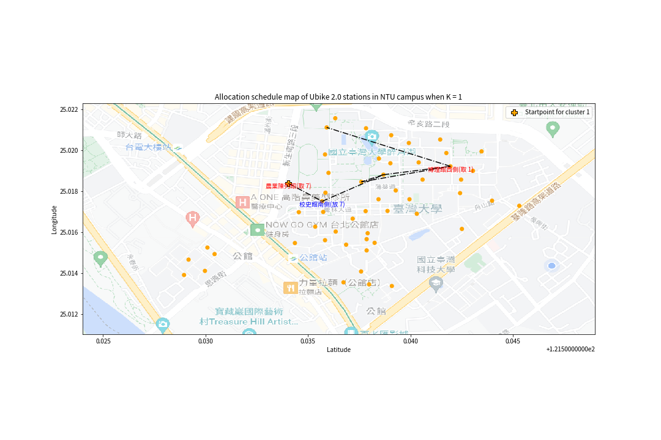
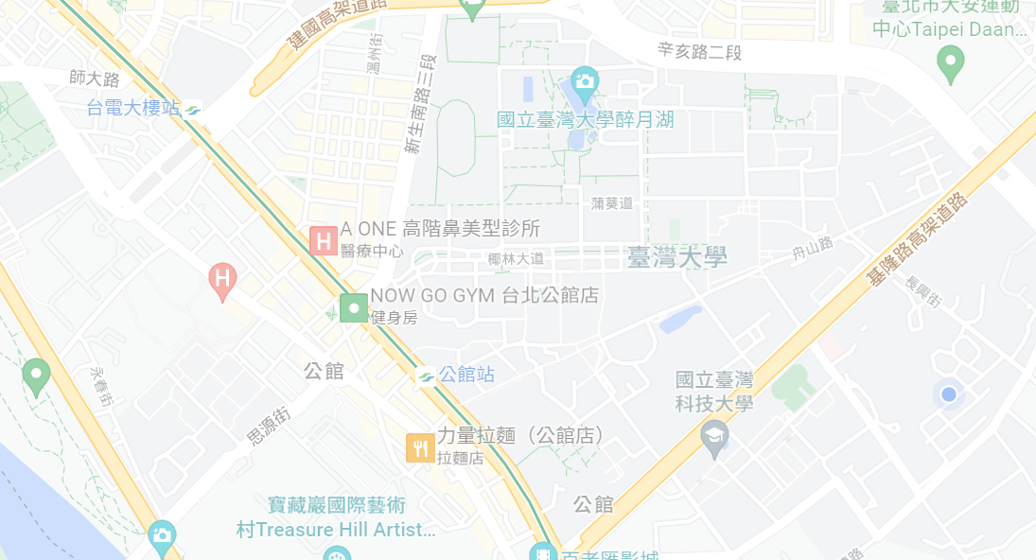

Slide 2
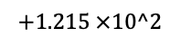
Allocation schedule map of Ubike 2.0 stations in NTU campus when K =1
25.022
25.020
25.018
25.016
25.014
25.012
Longitude
0.025 0.030 0.035 0.040 0.045
$$+1.215 ×10^2$$
Latitude

Slide 3
Allocation schedule map of Ubike 2.0 stations in NTU campus in Instance 2
25.022
25.020
25.018
25.016
25.014
25.012
Longitude
121.525 121.530 121.535 121.540 121.545
Latitude

Slide 4
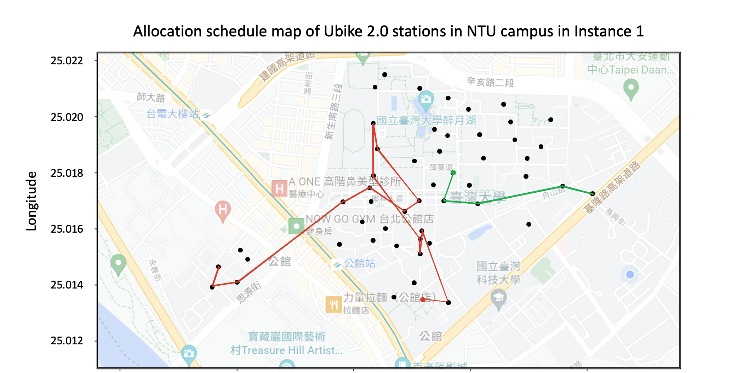
Final
121.525 121.530 121.535 121.540 121.545
Latitude

Slide 5
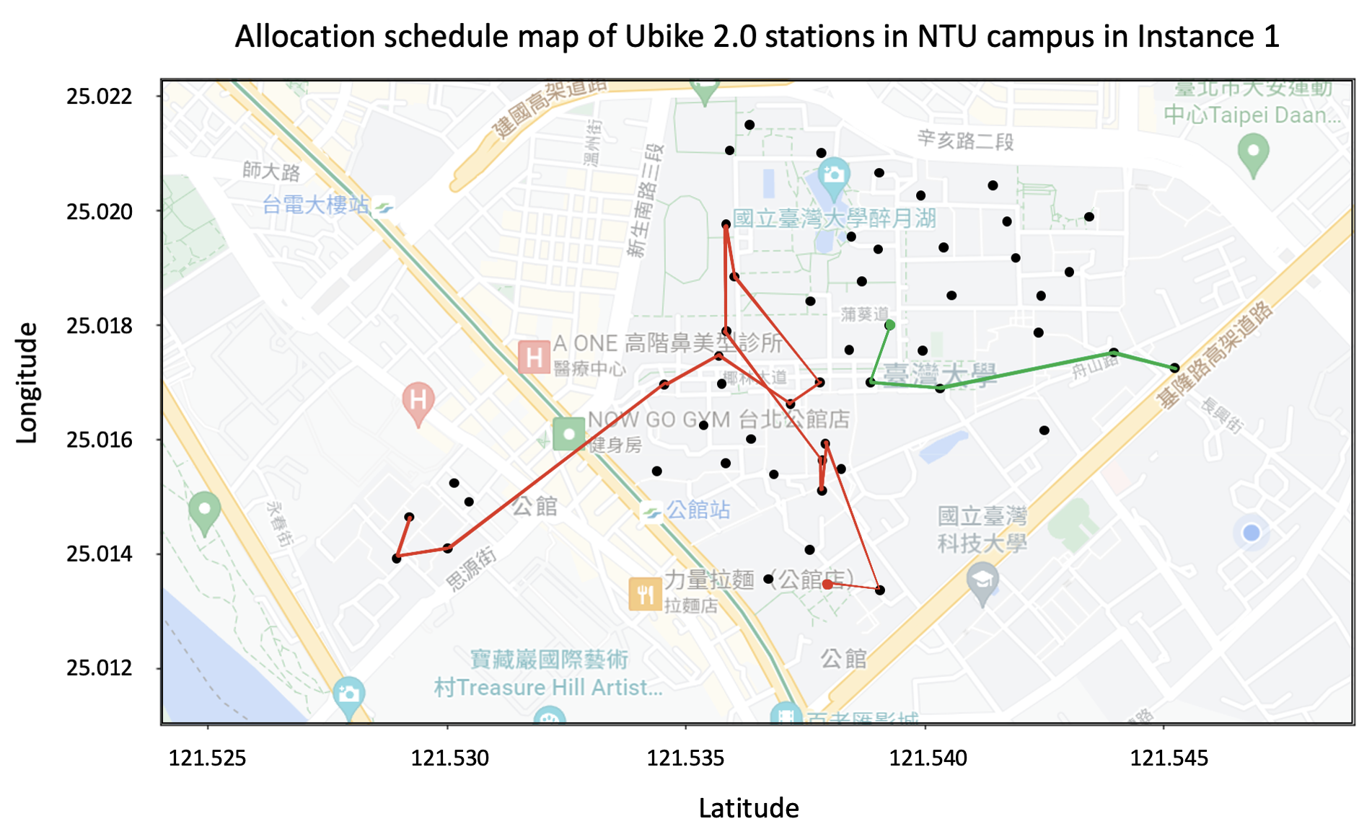
Final

Slide 6
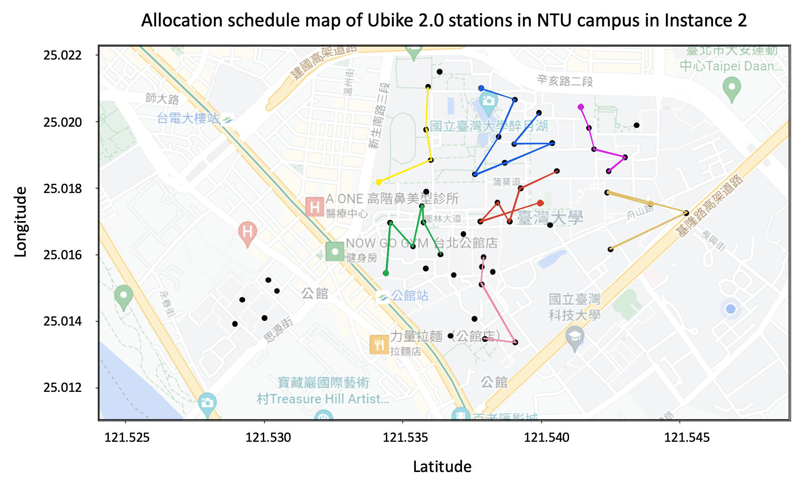
Final

